Slide 1
The Face of European Philanthropy
From Scale and Scope to Performance and Impact
ERNOP Conference │Copenhagen │13 -14 July 2017
Helmut K. Anheier │Hertie School of Governance│ Heidelberg University

Slide 2
Three arguments about foundations in Europe
Diversity
  Form
  Size
Behavior and Purpose
  Strategic philanthropy
  Alternative options
Time & Scale
  Time-limited
  Smart pooling

Slide 3
Recall…
Having mapped the institutional landscape of philanthropic foundations in terms of forms, numbers and size …
Having examined the social and political history of philanthropy and its institutional forms across countries...
Having proposed classifications of philanthropy, mostly in the context of a larger nonprofit sector... And
Having come up with initial theories explaining variations in scale and scope...
We approach the next set of tasks ...

Slide 4
Europe
Multitude of foundation forms
Models that go beyond charity/philanthropy/strategic philanthropy distinction
Need to “brand” foundations as European institutions, not in reference to US “gold standard”
Context specific developments (welfare states, nonprofit regimes, varieties of capitalism)

Slide 5
Institutional Map more complex for Europe
Anheier et al. 2017

Slide 6
Diversity across countries (Europe)
Context | Form Diversity | Roles of Foundations | Importance
Social democratic | Low | Smaller | Limited, stable
Statist | Low to medium | Smaller | Limited but growing
Corporatist | High | Larger | Significant
Liberal | Medium | Larger | Significant
Mediterranian | Medium | Medium | Less significant
Post socialist | Medium to high | Smaller | Limited but growing

Slide 7
Diversity within countries (Germany)
Approach | Smaller endowments / expenditures | Larger endowments / expenditures
Operating and mixed foundations | Niche providers 29% of all foundations - 1% of expenditures | Services providers 15% - 43%
Grant-making foundations | Engagement foundations 42% - 2% | Professional philanthropists 14% - 54%
Sample size = 1,004; total number of foundations in 2014 about 18,500
Small = Less than € 100,000 spending annually
Large = € 100,000 plus spending annually
Anheier et al. 2017

Slide 8
Small Foundations, Social implications
About 18,800 private foundations (as of 2014)
Three fourth (73%) founded after 1990 (ca. 13,700).
About half 54% have budget of less than 50,000 Euro (ca. 10,200).
Of which 84% are local (ca. 8,600).
Which engage an estimated 56,000 volunteers
These are on average connected to 231* people
To create a network of 13 million people
They offer the social glue of local middle class society (Mittelstand)
impact and performance may be less important than the very fact of caring
* Bernard-Killworth Median

Slide 9
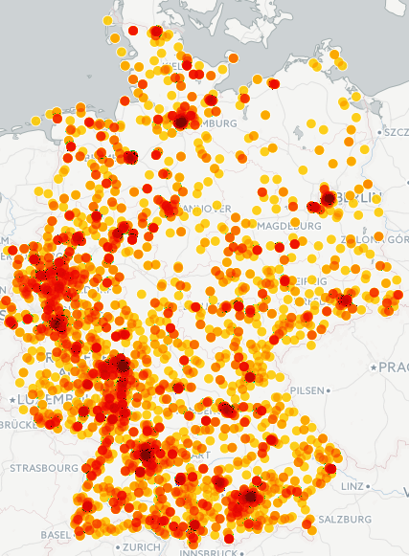
Germany
Only 1 in 10 has expenditure of more than € 1 million; over half less than € 50,000
Proportional approx. to population distribution
Anheier et al. 2017

Slide 10
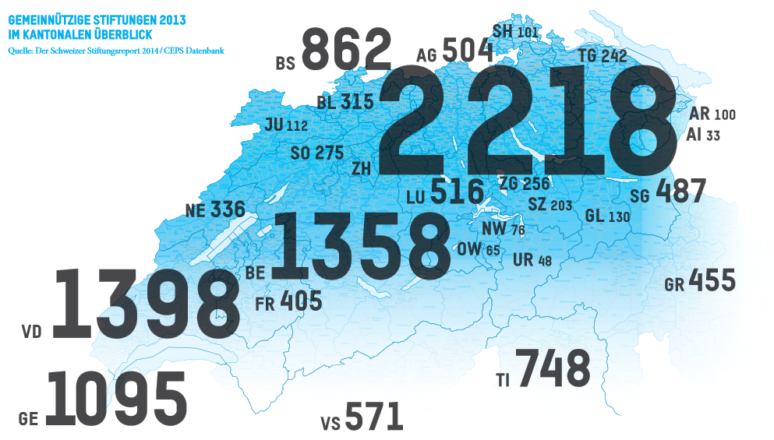
Similar in Switzerland
Most foundations are small
About one forth has endowments of 5 Mio. CHF, about 85% fewer than 5 Mio. CHF
Eckhardt, Jakob & von Schnurbein 2014

Slide 11
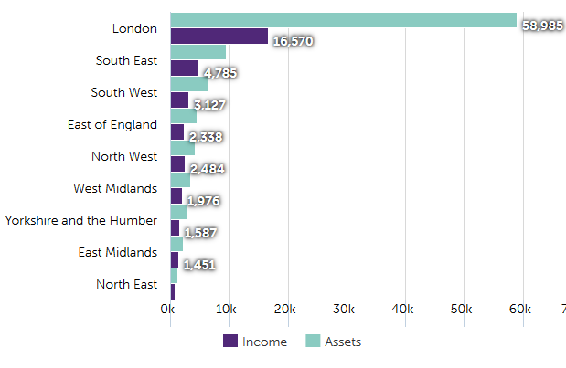
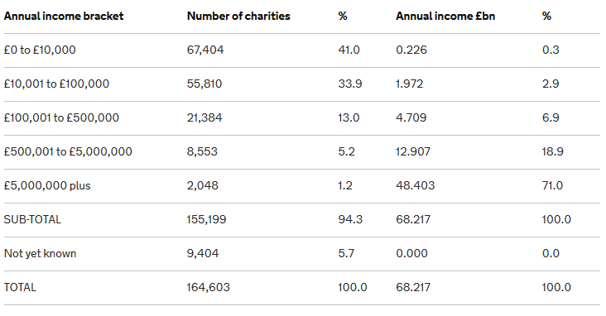
UK
Sector income and assets across regions, 2012/13 (£ millions)
About 63% of endowment in London
43% of UK charities have budgets of below 10k GBP, 71% of revenue concentrated in 1%
Source: https://data.ncvo.org.uk/dataview/income-assets-across-regions/

Slide 12
Argument I. Diversity
Dometic form diversity to be more fully explored
Most foundations are small, large foundations are few, very large ones even rare
Some countries show geographical concentrations in terms of numbers and wealth
Implications: role of donor and professionals may be different in highly concentrated foundation fields vs. smallness and localism
Impact argument vs. civil society argument

Slide 13
Argument II. Behavior / Performance
Performance and impact: for whom?
As in the case of scale & scope, there is a US concentrated approach on performance measures and impact assessment
  Strategic philanthropy
  High impact or catalytic philanthropy
  Etc.
How relate to diversity of European experience?

Slide 14
Strategic Philanthropy
“The case for strategic philanthropy ultimately is based on the belief that the intentional, systematic, and rational pursuit of an outcome increases the chances of achieving it” (Brest 2015).
Underscoring this conviction is the use of terms like `flight plan’ and related imagery for describing the sequence of decisions and actions towards intended goals or results.
Clear objectives; means-end relations; measurable performance criteria, milestones.
Of relevance to larger foundations in professional fields.

Slide 15
Perhaps…
Smaller foundation may not want to be strategic, and do not have to, may not even know the term (73%!)
Larger foundations often want to be strategic and may not know how to, some do.
Perhaps all, could benefit from Hirschman´s insight?
Mangold 2017

Slide 16
Strategic Philanthropy
Strategic philanthropy is a set of decisions and actions intended to achieve some desired outcomes under conditions of uncertainty and through ways and means that are beyond quick fixes and that require some level of flexibility, innovativeness, even creativity.
If that were not the case, we would not have to be strategic in the first place and could apply standard operating procedures.

Slide 17
The Hiding Hand
Hirschman argues that if planners or entrepreneurs had known in advance all the difficulties and troubles that were lying in store for a project, they probably would never have touched it. But why did they?
That is where the principle of the Hiding Hand comes in:
For Hirschman, by necessarily underestimating our creativity or resourcefulness ex ante, we may well underestimate to a roughly similar extent the difficulties of the tasks itself. In a way, we trick ourselves “by these two offsetting underestimates into undertaking tasks which we can, but otherwise would not dare, tackle.”
Hirschman 1967

Slide 18
The Hiding Hand & Creative Philanthropy
Creative Philanthropy kicks off a process towards some desired goal without fully knowing how to achieve it, nor knowing all consequences of intermediary steps or achieving the actual outcomes - we are letting ourselves be tricked by two similar offsetting underestimations:
That it can be done within our means and in known ways.
That it is not that difficult after all, that all can be achieved if only we are good at what we do.
The dual independence of foundations from market considerations and the ballot box, gives them immense freedom to letting themselves being tricked. No dominant stakeholder keeps foundation ambitions in check – and this is the source of their true resourcefulness and innovative potential.
Anheier and Leat 2006

Slide 19
The Hiding Hand
Could it be that some or perhaps many of the proud achievements of philanthropy were of this kind: taking on seemingly impossible tasks but believing they are achievable, while assuming that we have what it takes?
Would Rockefeller have founded universities otherwise? Would RCT have engaged in the Northern Ireland Peace Process, Mercator in setting up a migration council, or KBF in a project to teach imams?

Slide 20
Complexity and Potential
 | Underestimation Innovative Potential | Overestimating Innovative Potential
Underestimating Problems, Complexity of Tasks Required | Tricked into action Strategic Philanthropy | Self-confidence trickster Hype Philanthropy
Overestimating Problems, Complexity of Tasks Required | Missed opportunity Timid Philanthropy | Inexperience Dilettante Philanthropy

Slide 21
Argument III. Time and Pooling
Many small foundations, many getting smaller over time… Is that not inefficient?
Yes, options new and old to be explored:
  Pooling
  Time-limited

Slide 22
What are the issues?
Long-standing debate around perpetuity
  Turgot´s dead-hand problem (real estate, landed elite); anti-clerical elements, delivery failure
  Kant´s principle of utility (feared obsolescence, state primacy in allocating foundations to best public use)
  ------------
  Nielson: irremediable defect of being vulnerable to loss of spirit of first origin
  Prewitt: The enlightenment did not foster development of foundations

Slide 23
Underlying Issue
Can private funds of considerable size serve public purposes better if
donor intend can be changed in part or completely over time, even against the original stipulations of the deed?
donors can decide on time horizons other than perpetuity, and change it over time?
If so: who decides, regulates?

Slide 24
Current Issues
Financial: Low interest, low inflation environment of 2010s versus high interest, high inflation environment of 1970s.
Social Ecology: many new foundations being created, most rather small
Large, visible foundations as spend-downs:
  US: Atlantic, Gates
  UK: 4-Acres, Princess Diana Fund
  Germany: Forced-Labor-Foundation, Mummert Stiftung

Slide 25
Underlying Issue
Size:
  Efficiency: how to deal with growing numbers of smaller foundations that may not be well-managed (financial performance, governance), heading towards early obsolescence?
  Effectiveness: how can smaller foundations still achieve some impact (added value), also related to legitimacy?
Donors (supply side):
  Some, perhaps more, donors prefer time-limited deeds
Problems (demand side):
  Some problems require quicker, concentrated action, hence spending

Slide 26
Initial Impressions
UK: some 20, ACF, some debate
France: endowment funds next to foundations
Germany: 2013 reform; limited number; some debate, mostly about tax
Spain: no information
Austria: exist, no data, no debate
Sweden: no information, no debate
Netherlands: no information, no debate
Switzerland: do exist, great flexibility
Belgium: some debate about KBF
Italy: no information
EU: European Foundation Statute allows it, unlikely to pass
---------
Canada, Australia: exist, some debate

Slide 27
Differentiations cont.
Foundations established in perpetuity
Mixed foundations with permanent and flexible assets (note: flexible part can be spent and/or replenished)
Time-limited, spend-down foundation (“consumptive foundation,” i.e. consumes its own assets while realizing deed / objectives)
Conclusion
time limited foundation adds goal & performance aspects next to sustainability principle / parallelism not yet settled

Slide 28
Three messages, by way of conclusion
Let research agenda not be dominated by
Grant-making foundation (consider variety of forms)
Large foundations (consider smaller endowments)
Foundations established as permanent entities (consider time-limitation)

Slide 29
Sources
Anheier, H., Förster, S., Mangold, J., & Striebing, C. (2017). Stiftungen in Deutschland 1: Eine Verortung. Wiesbaden: Springer VS.
Brest, P. (2015). Strategic Philanthropy and Its Discontents. Stanford Social Innovation Review. Retrieved from https://ssir.org/up_for_debate/article/strategic_philanthropy_and_its_discontents.
Eckhardt, B., Jakob, D., & von Schnurbein, G. (2014). Der Schweizer Stiftungsreport 2014. Basel: CEPS, Centre for Philanthropy Studies, Universität Basel.
Hammack, D,. & Anheier, H. (2013). A Versatile American Institution: The Changing Ideals and Realities of Philanthropic Foundations. Washington, DC: Brookings.
Hirschman, A. O. (1967). ‘The Principle of the Hiding Hand’, The Public Interest, 10-23.
Kant, I. (1797): Die Metaphysik der Sitten. Retrieved from https://korpora.zim.uni-duisburg-essen.de/Kant/aa06/Inhalt6.html.
Mangold, J. (2017). Strategische Philanthropie. In H. Anheier, S. Förster, J. Mangold, & C. Striebing (Eds.), Stiftungen in Deutschland 3: Portraits und Themen (pp. 93-108). Wiesbaden: Springer VS.
Nielsen, W. (1996). Inside American Philanthropy. The Dramas of Donorship. Norman: University of Oklahoma Press.
Prewitt, K., Dogan, M., Heydemann, S., & Toepler, S. (Eds.) (2006). The Legitimacy of ­Philanthropic Foundations: United States and European Perspectives. New York, NY: Russell Sage Foundation.
Turgot, J. (2007). Endowments. In A. A. Kass (Ed.)., Giving well, doing good: readings for thoughtful philanthropists (pp. 333-338). Bloomington: Indiana University Press.

