Slide 1
The changing face of philanthropy:
Peer-to-peer (P2P) fundraising
Sarah Smith
University of Bristol
ERNOP Conference, Copenhagen, July 2017

Slide 2
Donor
Donor
Fundraising ask
Charity
Traditional fundraising

Slide 3
Donor
Donor
Donor
Donor
Donor
Donor
Fundraising ask
Individual
fundraiser
Individual
fundraiser
Charity
Charity
Traditional fundraising
Peer-to-peer fundraising

Slide 4
Members of fundraisers’ social network
Donor
Donor
Donor
Donor
Donor
Donor
Personal ask
Personal ask
Fundraising ask
Individual
fundraiser
Individual
fundraiser
Charity
Charity
Traditional fundraising
Peer-to-peer fundraising

Slide 5
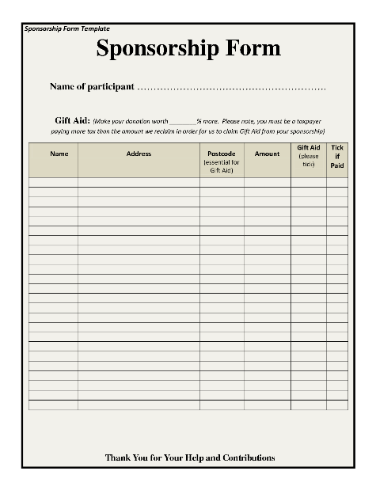
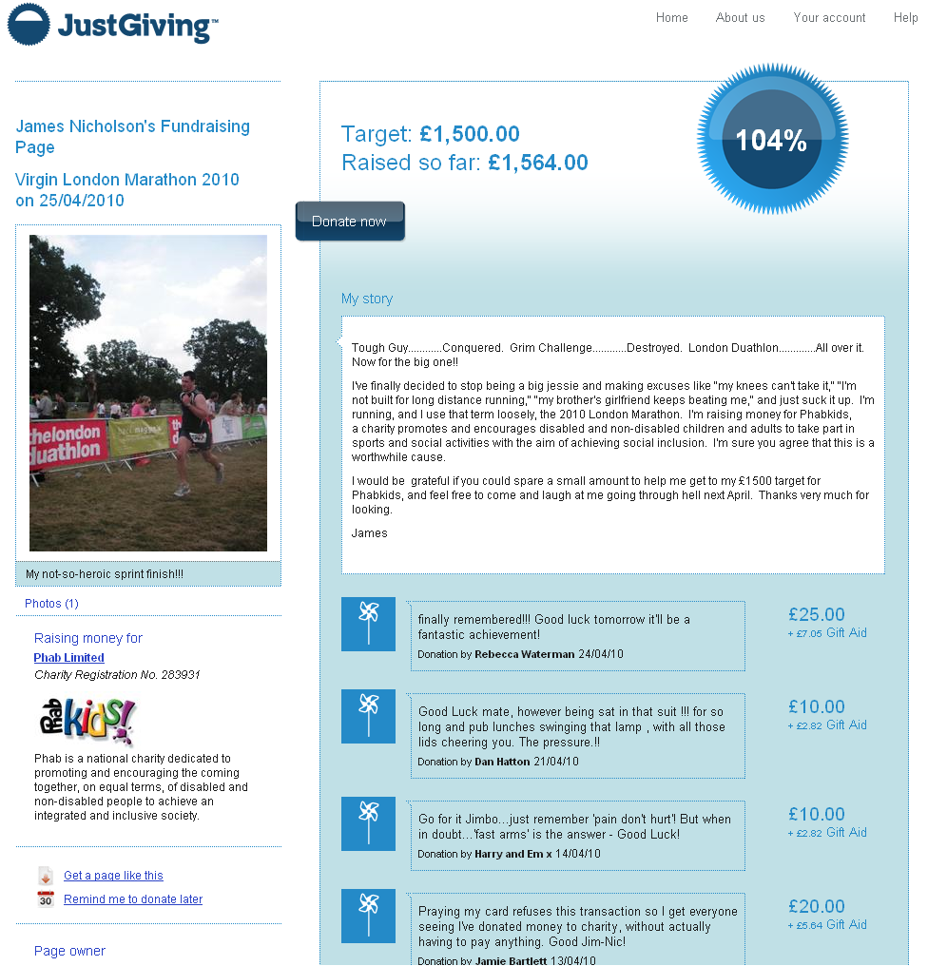
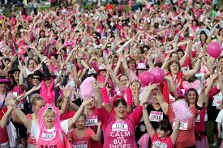
P2P fundraising is not new
But it is being transformed
  Online fundraising platforms
  Mass participation events
  Broader societal changes

Slide 6




The old way
Individuals as (passive) consumers
Authority and information come from traditional institutions
The new, networked way
Individuals as sharers, shapers, producers, co-owners
Authority and information are personalized and networked

Slide 7
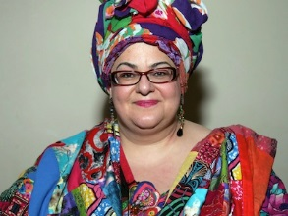
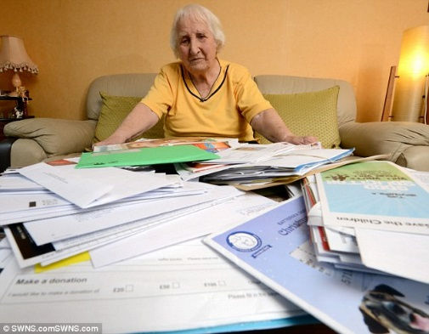
The old way
Individuals as (passive) consumers
Authority and information come from traditional institutions
2016 public trust in UK charities was down to 5.7 (out of 10) from 6.7 in 2012, 2014
  Charity mismanagement
  Perceived excessive fundraising pressure
    74% agree that some fundraising techniques make them uncomfortable (up from 60% in 2010)
The new, networked way
Individuals as sharers, shapers, producers, co-owners
Authority and information are personalized and networked

Slide 8
The old way
Individuals as (passive) consumers
Authority and information come from traditional institutions
2016 public trust in UK charities was down to 5.7 (out of 10) from 6.7 in 2012, 2014
  Charity mismanagement
  Perceived excessive fundraising pressure
    74% agree that some fundraising techniques make them uncomfortable (up from 60% in 2010)
The new, networked way
Individuals as sharers, shapers, producers, co-owners
Authority and information are personalized and networked
In the UK in 2015
  3.5m took part in the top 25 mass fundraising events
  32% sponsored someone (62% gave)
  P2P accounted for one-third of online donations

Slide 9
Overview
What does P2P fundraising look like?
The importance of social interactions
Competition in P2P fundraising (mass events)
Discussion

Slide 10
“Peer effects in charitable giving: Evidence from the (running) field” Economic Journal (2015) with Frank Windmeijer and Edmund Wright
"Competitive helping in online giving" Current Biology (2015) with Nicola Raihani
“Online Fundraising – the Perfect Ask?” in Social Economics (eds M. Macis and J. Costa-i-Font) MIT Press (2016) with Abigail Payne and Kimberley Scharf
“Relational altruism: Giving and social groups” Journal of Public Economics (2016) with Kimberley Scharf
“Social fundraising” (mimeo, 2017) with Abigail Payne and Kimberley Scharf

Slide 11
Overview
What does P2P fundraising look like?
The importance of social interactions
Competition in P2P fundraising (mass events)
Discussion

Slide 12
Fundraising
goal
Profile
photo
Fundraising story
What and why
Donations are
listed sequentially,
most recent first
Charity
Amount raised: median=£170; mean=£320
Number of donations: median=10; mean=15
Donation size: median=£10; mean=£21

Slide 13
£ raised
(% fundraisers)
4.0%
1.3%
24.1%
0.6%
37.4%
11.3%
17.0%
1.8%
0.3%
“Online Fundraising – the Perfect Ask?” (2016) with Abigail Payne and Kimberley Scharf

Slide 14
Event | Charity | Amount raised in 2014
Oxford Thinking | Oxford University | £200.0m+
Red Nose Day (telethon) | Comic Relief | £100.3m
Virgin London Marathon | Various | £53.2m
Race for Life | Cancer Research UK | £51.0m
BBC Children in Need appeal (telethon) | Children in Need | £49.1m
Ebola Crisis Appeal | Disaster Emergency Committee | £34.0m
World’s Biggest Coffee Morning | Macmillan Cancer Relief | £20.5m
Movember | Movember Foundation | £20.0m
Gaza crisis appeal | Disaster Emergency Committee | £19.0m
Moonwalk | Walk the Walk | £7.5m
Ice Bucket Challenge | Motor Neurone Disease Association | £7.0m
London to Brighton Cycle Ride | British Heart Foundation | £4.4m
Shine (Walk) | Cancer Research UK | £4.3m
Dryathlon | Cancer Research UK | £4.2m
Swimathon | Marie Curie Cancer Care | £2.9m
Go Sober October | Macmillan Cancer Relief | £2.4m
Wear it Pink | Breast Cancer Campaign | £2.1m

Slide 15
Mass versus DIY events
Mass event: single-day and location; many fundraisers, many possible charities (eg London marathon)
Charity mass event: single-day and location; many fundraisers, one charity (Race for Life).
DIY: individual is the sole fundraiser in a unique event
 | % pages | Number of donations | Amount raised | % who fundraise again
Mass event | 44.8% | 22 | £588 | 19.0%
Charity mass event | 38.1% | 16 | £439 | 19.5%
DIY | 17.1% | 25 | £853 | 15.0%
“Online Fundraising – the Perfect Ask?” (2016) with Abigail Payne and Kimberley Scharf

Slide 16
Overview
What does P2P fundraising look like?
The importance of social interactions
Competition in P2P fundraising (mass events)
Discussion

Slide 17
Social interactions
Defining feature of P2P
P2P replaces “charity ask” with “personal ask” from a friend, family or colleague
  Taps into personal networks – expanding pool of potential donors
  Personal “ask” is potentially more powerful
47 per cent of P2P sponsors say that a personal connection to the fundraiser is an important factor in determining how much they give

Slide 18
Social interactions
Traditionally, economists have thought of motivations for giving (altruism or warm glow) primarily in relation to the charity/ cause
What if giving is primarily the outcome of social interactions with very little role for the charity/ cause?
  In their study of social pressure, Della Vigna et al (2015) claimed that 75% donors have no altruism towards the charity
  Scharf and Smith (2016) argue that donor behaviour can be understood in terms of donors’ altruistic feeling towards the fundraiser, not the charity or cause

Slide 19
Social interactions
Traditionally, economists have thought of motivations for giving (altruism or warm glow) primarily in relation to the charity/ cause
  While acknowledging role for social interactions

Slide 20
Social interactions
Traditionally, economists have thought of motivations for giving (altruism or warm glow) primarily in relation to the charity/ cause
  While acknowledging role for social interactions
But what if giving is primarily the outcome of social interactions with very little role for the charity/ cause?
  In their study of social pressure, Della Vigna et al (2015) claimed that 75% donors have no altruism towards the charity
  Scharf and Smith (2016) argue that donor behaviour can be understood in terms of donors’ altruistic feeling towards the fundraiser, not the charity or cause

Slide 21
Social interactions
Three examples:
  Peer effects
  Competitive altruism
  Group size effects

Slide 22
1. Peer effects
Donors on a fundraising platform can see how much other people have given
When asked, only 3 per cent of donors say that how much other people have given is an important factor in determining how much they give

Slide 23
1. Peer effects
In practice, donors respond strongly to how much other people have given
Thought experiment
Suppose someone arrives on a page just after a large donation (£100)
How much do they give, compared to if they had arrived just before the large donation?

Slide 24
Before/ after a ‘large’ donation
After (+£13*)
Before
Notes: A large donation is defined as twice the page mean and at least £50. We focus on the first large/small donation to occur on a pages. Effect sizes identified from within-page, linear regressions, controlling for order of donation on page; * p<0.05
Smith, S., Windmeijer, F., Wright, E. (2015) “Peer effects in charitable giving: New evidence from the (running) field”, Economic Journal

Slide 25
Before/ after a ‘large’ donation
Donors give 50% more (on average) if they arrive on the fundraising page just after a large donation compared to arriving just before
  Benchmarking = the overall level of donations increases
  Competing = they are more likely to make a large donation
No negative effect on whether people give
Or how much they give to other pages
The larger, the better? Yes, up to a limit
After (+£13*)
Before
Notes: A large donation is defined as twice the page mean and at least £50. We focus on the first large/small donation to occur on a pages. Effect sizes identified from within-page, linear regressions, controlling for order of donation on page; * p<0.05
Smith, S., Windmeijer, F., Wright, E. (2015) “Peer effects in charitable giving: New evidence from the (running) field”, Economic Journal

Slide 26
Before/ after a ‘small’ donation
Small donations have the opposite effect
Consistent with benchmarking
Before
After (-£11*)
Notes: A small donation is half the page mean. We focus on the first large/small donation to occur on a pages. Effect sizes identified from within-page, linear regressions, controlling for order of donation on page; * p<0.05
Smith, S., Windmeijer, F., Wright, E. (2015) “Peer effects in charitable giving: New evidence from the (running) field”, Economic Journal

Slide 27
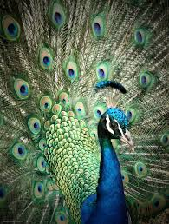
2. Competitive altruism
Are donations a (costly) way for males to signal their desirability (=pro-sociality) to a prospective mate?
Do males compete more when a desirable mate is present?
Raihani, R. and Smith, S. (2015) "Competitive helping in online giving" Current Biology

Slide 28
2. Competitive altruism
Are donations a (costly) way for males to signal their desirability (=pro-sociality) to a prospective mate?
Do males compete more when a desirable mate is present?
Pictures of fundraisers used to get independent ratings of attractiveness (via Mturk)
Competition measured by the strength of the response to a large donation (i.e. how much donations increase following a large donation)
Test: Does competition among male donors depend on the attractiveness of the female fundraiser?
Raihani, R. and Smith, S. (2015) "Competitive helping in online giving" Current Biology

Slide 29
How much more do male donors give after a large donation?
It depends on how attractive the (female) fundraiser is
Bars show the average increase in donation size following a large donation
Raihani, R. and Smith, S. (2015) "Competitive helping in online giving" Current Biology

Slide 30
3. Group size effects
P2P fundraisers appeal to their social groups. Their social groups differ in size
Is there a relationship between social group size (proxied by number of FB friends) and giving behaviour?

Slide 31
3. Group size effects
P2P fundraisers appeal to their social groups. Their social groups differ in size
Is there a relationship between social group size (proxied by number of FB friends) and giving behaviour?
Yes
  Fundraisers with larger social groups (=more FB friends) get more donations
  But each donor gives less
“Relational altruism: Giving and social groups” Journal of Public Economics (2016) with Kimberley Scharf

Slide 32
Relationship between group size and donation size
This is not the standard free-riding result
Number of contributors to the charity
≠ size of social group
We can condition on charity
But it is consistent with a model in which
donors care about the fundraiser,
making the amount raised by the
fundraiser a local public good
Not altruism (towards the charity),
but relational altruism (towards the fundraiser)
“Relational altruism: Giving and social groups” Journal of Public Economics (2016) with Kimberley Scharf

Slide 33
Social interactions
Take-aways
  P2P provides a rich lab for observing giving; these results provide insights and evidence on different aspects of philanthropic behaviour
  The growth of P2P in its new on-line form is giving rise to new models of philanthropy in which social interactions are the dominant drivers of behaviour

Slide 34
Overview
What does P2P fundraising look like?
The importance of social interactions
Competition in P2P fundraising (mass events)
Discussion

Slide 35
Competition in P2P fundraising
Race for Life, organised by Cancer Research UK is the UK’s biggest mass event
    Series of women-only 5k and 10k races staged at different locations around the country in May, June and July
  1000s of fundraisers in a single location at a single point in time, raising money for one charity
Do they compete with fundraisers for other charities?
Do they compete against each other?
  Mass event fundraisers raise less than DIY
The key problem is funding cannibalism….. Because people on average are limited in how much they’re willing to donate to good causes, if someone donates $100 to the ALS Association, he or she will likely donate less to other charities (William MacAskill)

Slide 36
Competition in P2P fundraising
We look at P2P donations by month within local areas for two causes (CRUK and other)
We estimate the effect of changes in the number of fundraisers for CRUK on total donations raised for CRUK and for other charities
We exploit variation in the number of fundraisers for CRUK linked to the timing of RfL races (staggered across May, June, July)
  We also use capacity constraints associated with specific race venues as an instrument for the number of CRUK fundraisers (plausibly exogenous variation in the number of fundraisers in different locations)

Slide 37
Number of fundraisers, CRUK and Other charities, by month: Feb 09 – Nov 10

Slide 38
How does the increase in fundraisers for CRUK affect the amount of money received by CRUK and other charities?
Impact of RfL on fundraisers
Some fundraisers may be diverted (↑CRUK, ↓OTHER)
Some new fundraisers may be attracted - increasing fundraising competition (?)
The fundraiser mix will change (?)
Impact of RfL on donors
The donor pool may increase (new fundraisers access different social groups)
But individual donors may give less
  If donors are altruistically motivated towards the charity (↓ CRUK)
  If donors start to receive multiple requests (↓ CRUK and OTHER)

Slide 39
Preliminary results: Own-charity elasticity
1% increase in the number of fundraisers for CRUK results in a 0.8% increase in contributions to CRUK. Own charity elasticity <1 indicates diminishing returns

Slide 40
Preliminary results: Own-charity elasticity
1% increase in the number of fundraisers for CRUK results in a 0.8% increase in contributions to CRUK. Own charity elasticity <1 indicates diminishing returns
There is limited fundraiser diversion
  Each additional CRUK fundraiser reduces the number of fundraisers for other charities by 0.2
  Comes at the expense of “other running” not “other health”

Slide 41
Preliminary results: Own-charity elasticity
1% increase in the number of fundraisers for CRUK results in a 0.8% increase in contributions to CRUK. Own charity elasticity <1 indicates diminishing returns
There is limited fundraiser diversion
  Each additional CRUK fundraiser reduces the number of fundraisers for other charities by 0.2
  Comes at the expense of “other running” not “other health”
Explanation for diminishing returns is not that the marginal fundraisers are less effective
  1% increase in fundraisers for CRUK → 0.05% drop in the amount raised by individual fundraisers (including fundraiser fixed effects)

Slide 42
Preliminary results: Own-charity elasticity
1% increase in the number of fundraisers for CRUK results in a 0.8% increase in contributions to CRUK. Own charity elasticity <1 indicates diminishing returns
There is limited fundraiser diversion
  Each additional CRUK fundraiser reduces the number of fundraisers for other charities by 0.2
  Comes at the expense of “other running” not “other health”
Explanation for diminishing returns is not that the marginal fundraisers are less effective
  1% increase in fundraisers for CRUK → 0.05% drop in the amount raised by individual fundraisers (including fundraiser fixed effects)
  The results indicate a negative, albeit small, effect of increased fundraiser competition
  Participants in mass events do take donations away from each other, but to a limited extent
  More participants mainly means lots more donations

Slide 43
Preliminary results: Cross-charity elasticity
1% increase in the number of fundraisers for CRUK leads to a 0.08% decrease in contributions to other (not statistically significant)
This is consistent with there being little fundraiser diversion
  Any diversion comes from other running not other health
Similarly, at the fundraiser level, there is little negative effect of an increase in CRUK fundraisers on the amount raised by individual fundraisers

Slide 44
Preliminary results: Cross-charity elasticity
1% increase in the number of fundraisers for CRUK leads to a 0.08% decrease in contributions to other (not statistically significant)
This is consistent with there being little fundraiser diversion
  Any diversion comes from other running not other health
Similarly, at the fundraiser level, there is little negative effect of an increase in CRUK fundraisers on the amount raised by individual fundraisers
  The results indicate few negative spillover effects from a mass event for other charities
  Fears of “fundraising cannibalism” for other charities are exaggerated

Slide 45
Overview
What does P2P fundraising look like?
The importance of social interactions
Competition in P2P fundraising (mass events)
Discussion

Slide 46
Discussion
P2P is currently the most successful “networked model” for the charity sector
It is a model of giving in which social interactions are the key driver
Attractive for charities, leveraging personal connections to bring in new donors
  Little evidence of fundraising cannibalism

Slide 47
Discussion
P2P is currently the most successful “networked model” for the charity sector
It is a model of giving in which social interactions are the key driver
Attractive for charities, leveraging personal connections to bring in new donors
  Little evidence of fundraising cannibalism
Is this desirable?
Success means attracting the most individual fundraisers = running the best events.
  CRUK diverts fundraisers from other running events, not other health charities
No worse than alternative in which donors respond to unwanted pressure from professional fundraisers (Della Vigna et al, 2015; Andreoni et al, 2017)

Slide 48
Discussion
P2P is currently the most successful “networked model” for the charity sector
It is a model of giving in which social interactions are the key driver
Attractive for charities, leveraging personal connections to bring in new donors
  Little evidence of fundraising cannibalism
Is this desirable?
Success means attracting the most individual fundraisers = running the best events.
  CRUK diverts fundraisers from other running events, not other health charities
No worse than alternative in which donors respond to unwanted pressure from professional fundraisers (Della Vigna et al, 2015; Andreoni et al, 2017)
Challenge to find alternative networked model that focuses on what charities deliver

Slide 49
Thank you!

