Slide 1


Slide 2



ERNOP July 1-2, 2021 - Dublin Welcomes you!

Slide 3




15 minutes
transfer to
city
4
14
Airlines
A compact, walkable
and accessible city
1
8
0
Destinations
US Customs & immigration
based in Dublin Airport

Slide 4


Your 2021 Local Host Committee

Slide 5
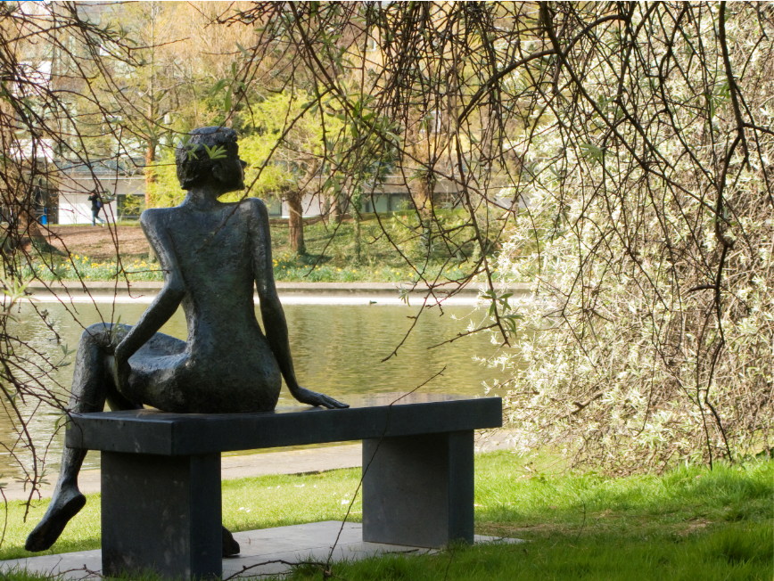

Conference Venue

Slide 6
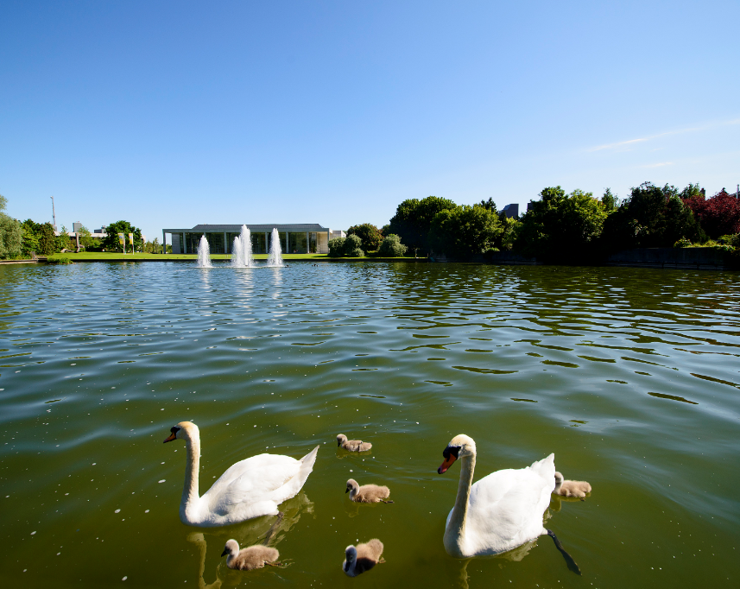
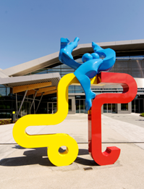


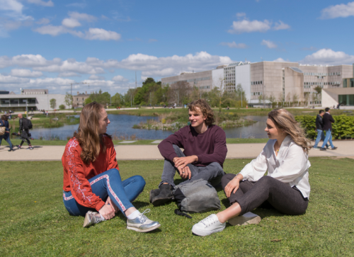
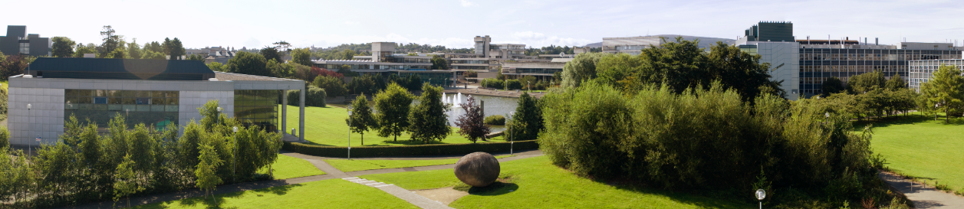


Slide 7
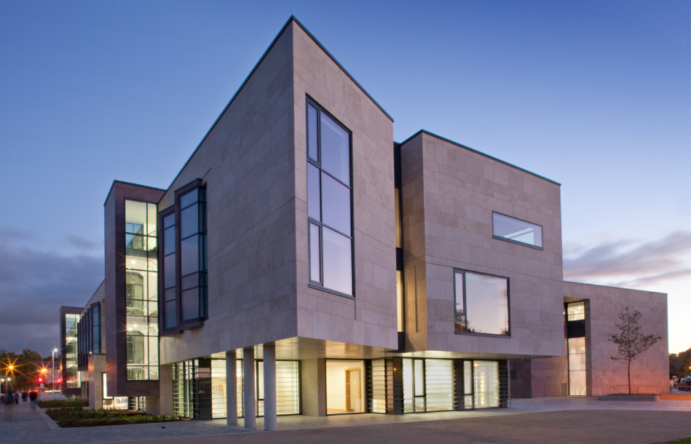


Slide 8
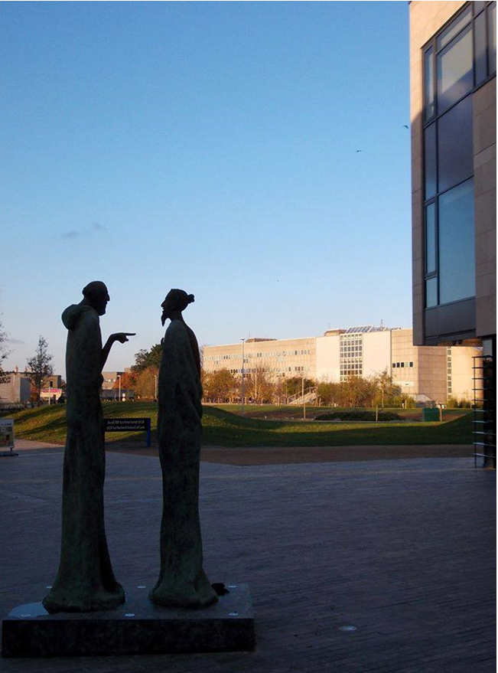
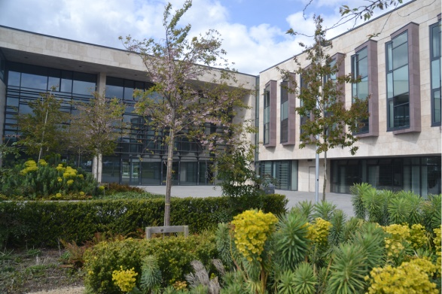
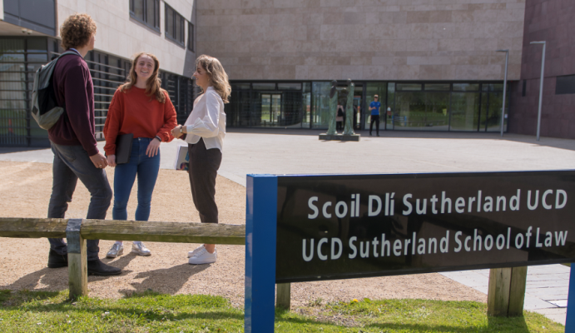

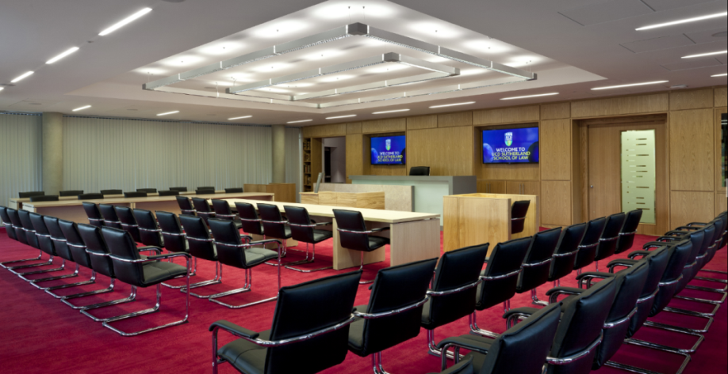
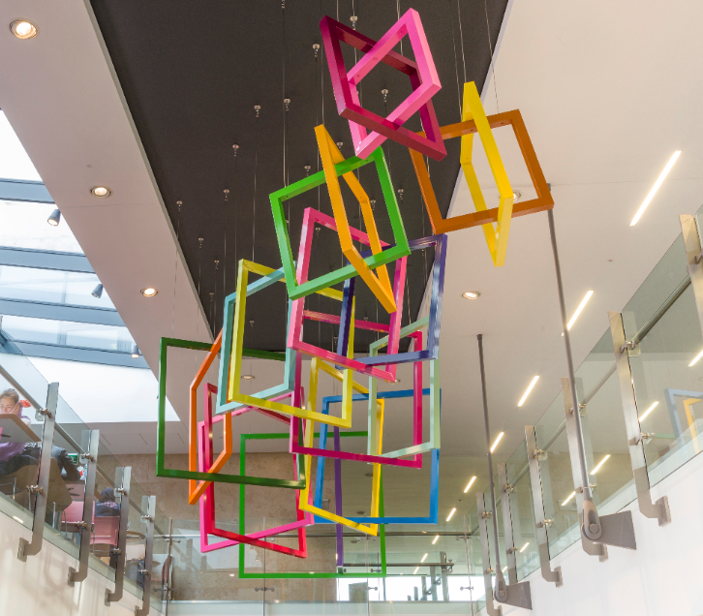
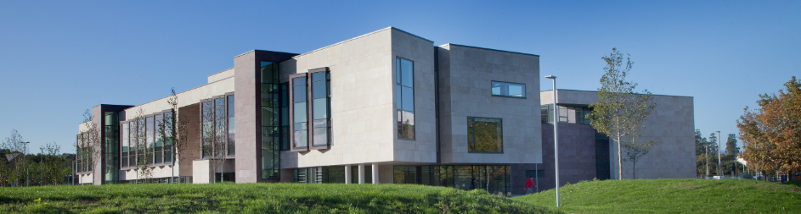

Slide 9
Come join us in Dublin – Ireland awaits you in July 2021!

