Slide 1
ERNOP Research Note
Academic articles on philanthropy through a practitioner lens
Full article
Volunteering most beneficial for elderly and less healthy Europeans
Arjen de Wit, Vrije Universiteit Amsterdam | Heng Qu, Texas A&M University| René Bekkers, Vrije Universiteit Amsterdam
The article examins the health advantages of volunteering for European adults.
Does volunteering have health benefits? And if so, who benefits most?
The results of the study suggest volunteering not only has a positive impact on society as a whole, but may also indicate a health advantage for volunteers over the age of 60 and for those in poor health. In almost all countries in Europe, volunteers report better health than non-volunteers, indicating it would be advisable for policy makers to promote volunteering as a possible route to better health and healthy ageing..
#Volunteering #Aging #Health #Society
Background
&
Context
Volunteers across countries in Europe report better health than non-volunteers. On average, volunteers score higher than non-volunteers when asked about their health.
Over time, volunteering contributes to health. Europeans who start volunteering stay in better health than those who remain inactive. Among volunteers who continue volunteering, health remains better than among those who quit.
The health advantage of volunteers increases with age. For respondents below the age of 60 the study finds no health advantage for volunteering. For volunteers above the age of 60 there is a health advantage. This advantage increases for respondents who are 80 years or older.
The health advantage of volunteers is largest for those in worse health. The health advantage of volunteering among those in worse health is twice as large as the health advantage among the healthiest Europeans.
Because volunteering may improve the health of older and less healthy adults, it would be good if public health policy makers would promote volunteering.

Slide 2
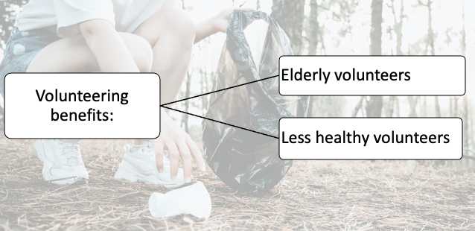
ERNOP Research Note
Academic articles on philanthropy through a practitioner lens
Take aways & Learnings
Most studies that claim volunteering is good for health, have been based on small samples and may have overestimated the effect of volunteering on health by not taking into account the factor that health enables people to volunteer in the first place.
This study reviewed data from almost one million observations from 267,212 adults (18 years or older) in six long-term panel studies in Europe, covering 22 countries over a maximum period of 33 years.
The study has been in the making for more than ten years, pooling together the data in a so-called mega-analysis, and has been carried out according to Open Science best practices.
On average, volunteers score 8 points higher than non-volunteers on a scale of subjective health from 0 to 100.
The analyses show that the advantage is due mostly to self-selection: individuals in better health are more likely to start and continue volunteering. Regardless of this, the study shows volunteering brings clear health benefits, especially for the elderly and less healthy volunteers.
Insert a visual element here
For example a histogram that shows the most important findings or conclusion, or any other picture or graph that is related to results or conclusions of the paper. Even tables are allowed, as long as they are self explicatory and easy to read
ERNOP Research Notes provide easy-to-read, practice-oriented summaries of academic articles on philanthropy and are written by practitioner experts. This ERNOP Research Note 2023/11 is published in June 2023 and has been provided to you by Katherine Hermans from Global Changemakers. More information can be found at www.ernop.eu.
University logo
Your logo

