Slide 1
The SDG-Partnership Connectome
Multimodal AI empowers the Philanthropy of the Future
Panelists: Dr. Lucia Gomez, Julia Litofcenko, Dr. Sevda Kilicalp, Maria Tudor
Moderator: Prof. Giuseppe Ugazio

Slide 2
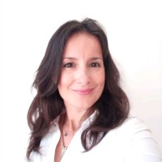
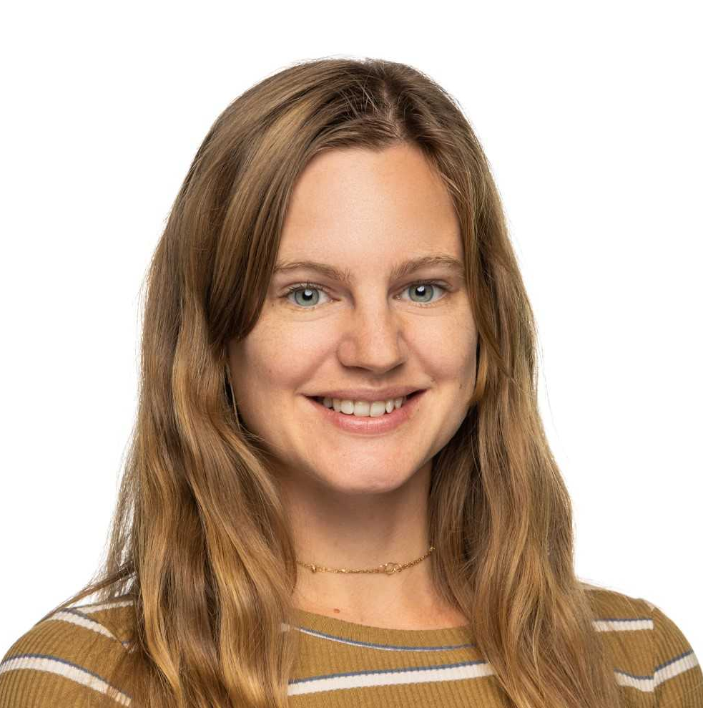
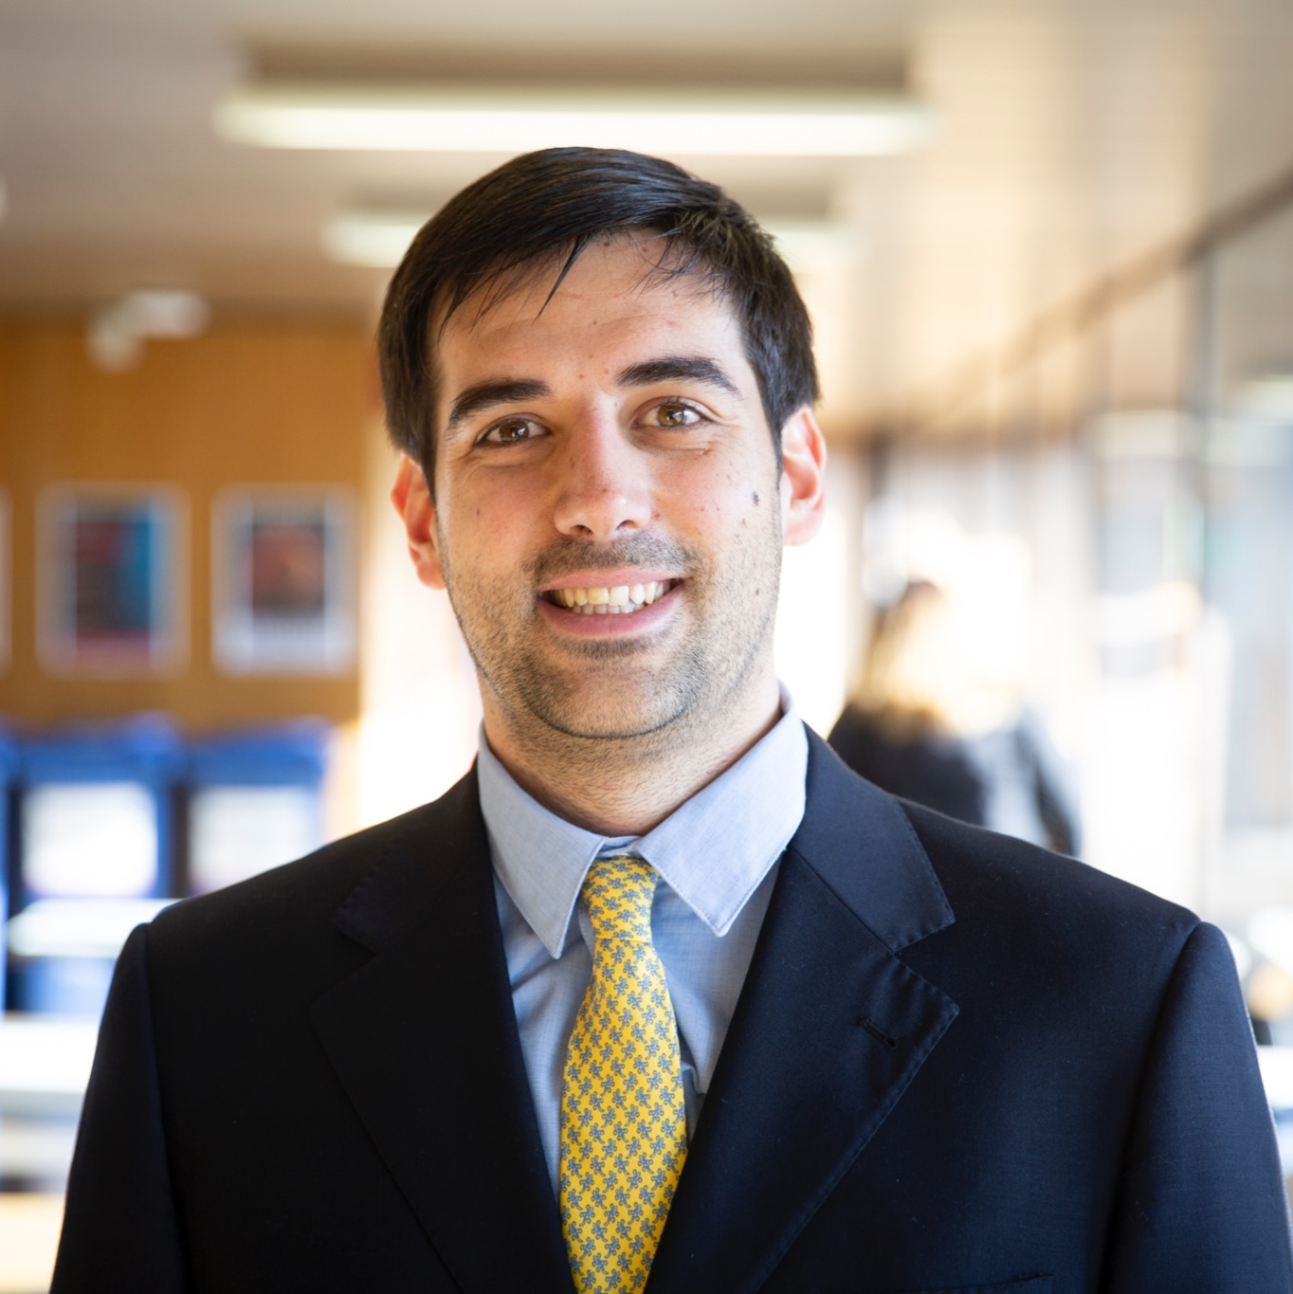
The Speakers
Dr. Sevda Kilicalp
Head of Research &
Knowledge Development
PHILEA
Julia Litofcenko
PhD Student
Institute for NonProfit Management
WU Vienna
Dr. Lucia Gomez Tejeiro
AI & Data Science
Postdoctoral Researcher
University of Geneva
Maria Tudor
AI & Philanthropy
Research Assistant
University of Geneva
Moderator
Prof. Giuseppe Ugazio
Head of Behavioral Philanthropy Lab
University of Geneva

Slide 3
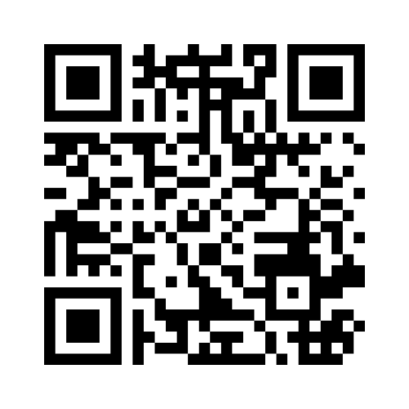
Are you familiar with AI?
https://www.menti.com/alk4wy7748nh

Slide 4
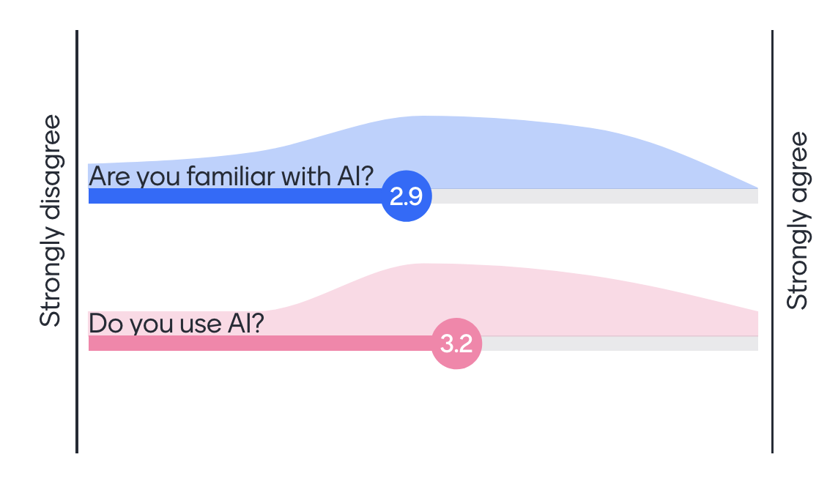
Are you familiar with AI?

Slide 5
Panel Outline
Convergence
&
Partnerships
AI Use
in
Philanthropy
AI Ethics
&
Inclusion

Slide 6
Convergence & Partnerships
Convergence
&
Partnerships
Natural Language Processing (NLP)
Networks maps of mission-aligned organizations
Partnership Recommendations
AI Use
in
Philanthropy
AI Ethics
&
Inclusion

Slide 7
Natural Language Processing (NLP)?
Interaction between computers and human language
Goal: Enable computers to understand, interpret and generate human language
Examples: deepl, grammarly, chatGPT…

Slide 8
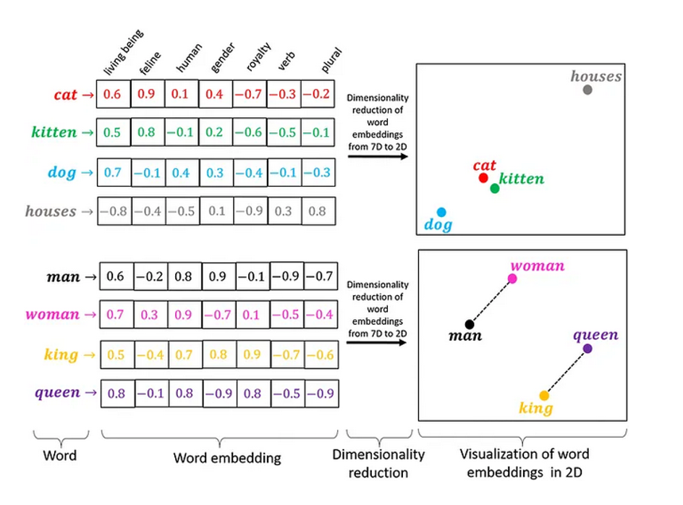
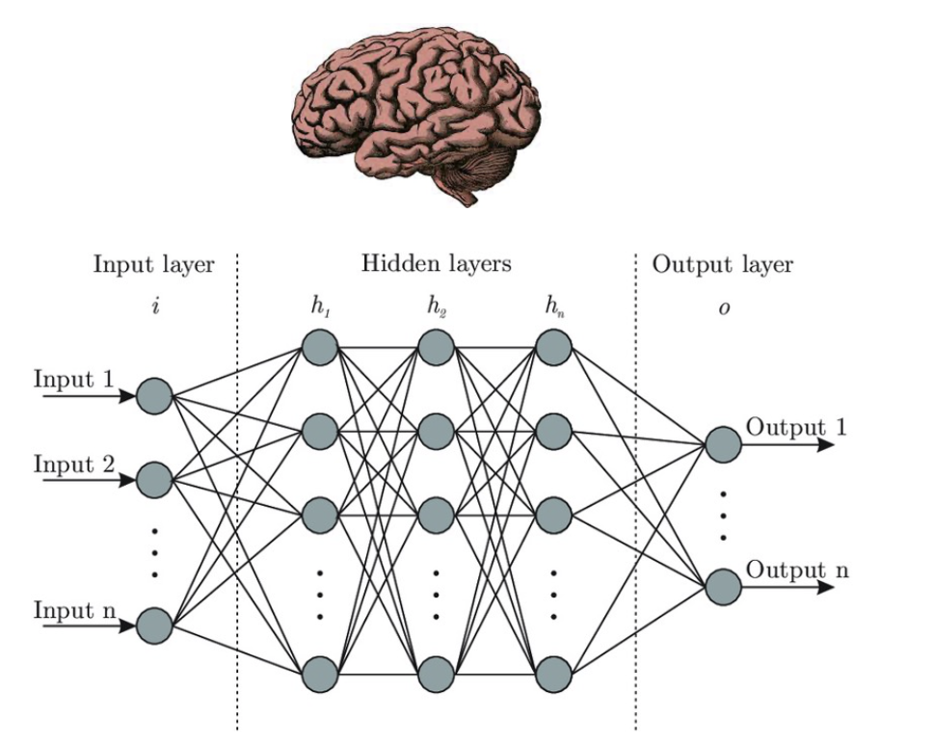
The first models: Bag Of Words
Bag Of Words
Word Embeddings
Neural Networks

Slide 9
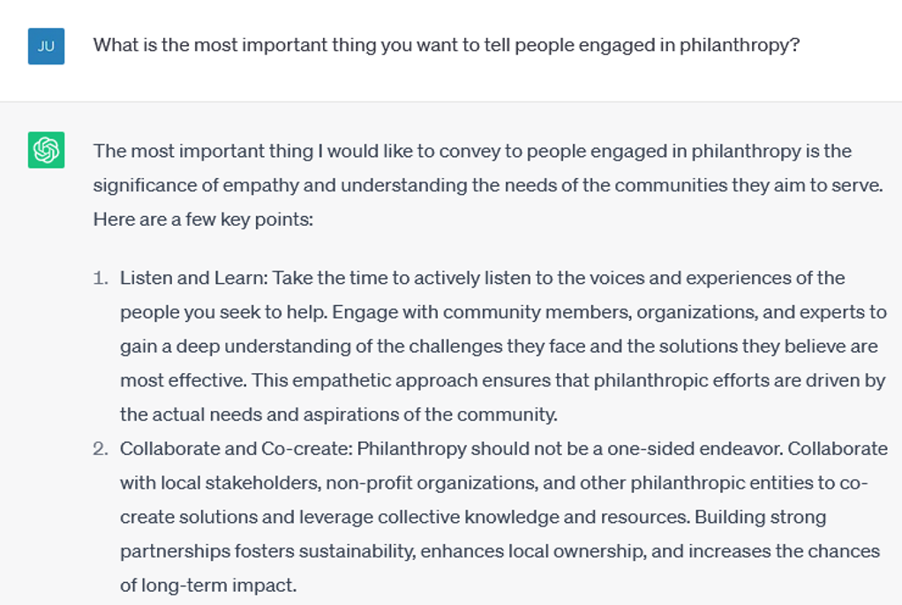
NLP example : ChatGPT

Slide 10
NLP for Philanthropy Research
Sentiment analysis and dictionary approaches:
How positive vs. negative is a text?
Content on moral values, religion, inequality, duty…?
Classification:
Was the text written by an man or women?
Individualistic or collectivist cultural background?
Unsupervised approaches:
Frequent topics? Areas of philanthropy (education, arts,…)?
Bibliographic analysis
Tools for the research process: ASReview, Laser AI, Scite…
Y.-W.Chen & Nakazawa, 2017
Paxton et al., 2020
H. Chen & Zhang, 2021; Fyall et al., 2018; LePere-Schloop, 2022; Ma, 2021; Santamarina et al., 2021
Powell et al., 2016
Kang et al., 2022;
Ma et al., 2021;
Santos et al., 2020

Slide 11
Convergence between FPs & NPs?

Slide 12
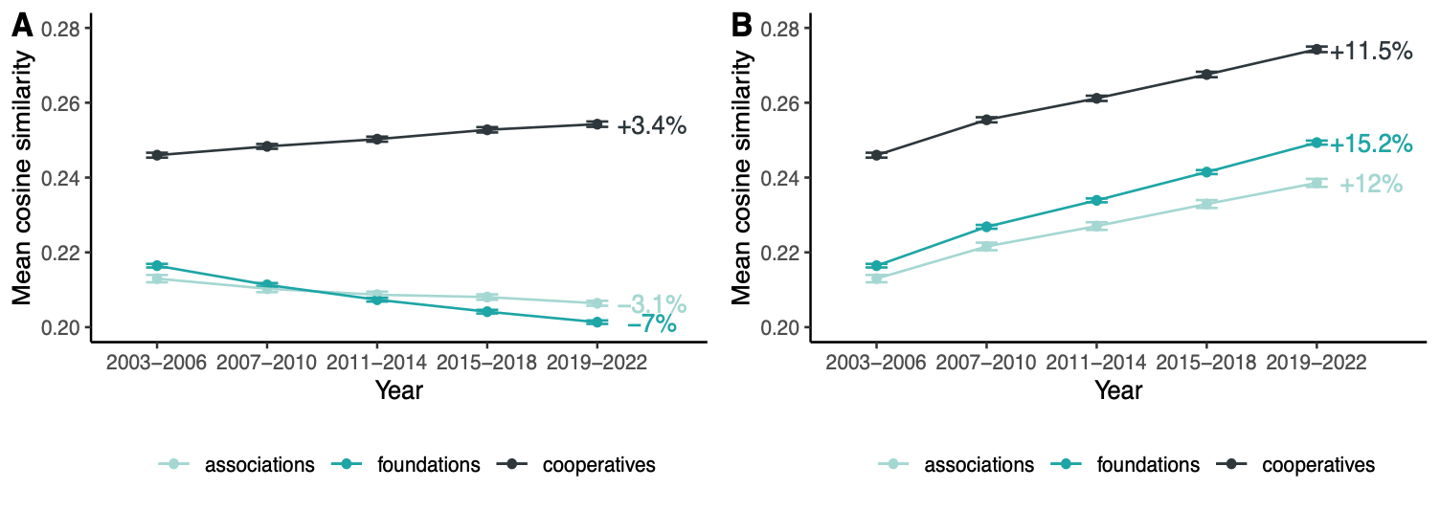
Who is becoming similar to whom?
For-Profits present as more socially responsible, whereas nonprofits do not adopt the language of For-Profits in mission statements

Slide 13
Take Home Messages
For-profits and non-profits converge
For-profits venture into areas which have traditionally served by nonprofits (health and care, environmental protection)
Barely signs of mission drift among non-profits
Collaborations that combine the strengths of both sectors become easier

Slide 14
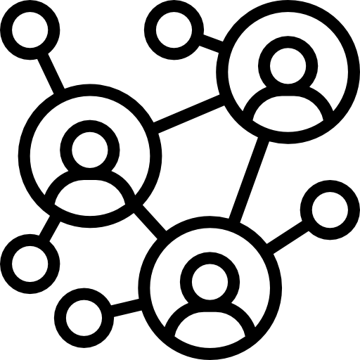
Philanthropic Organizations’ role for the SDGs
SDGs advancements require coordinated multi-stakeholder action
Governments, private sector, civil society, NGOs, Philanthropic Organizations (POs)
POs play a unique role
Risk & Innovation
Niche causes - issues not covered by other actors
Advocacy & Awareness
POs - Unlocking additional SDG financing
Funding gap to meet the SDGs by 2030:
USD 2.5 trillion per year in addition to current expenditure (SECO, 2020)
Potential to unlock finances:
USD 651 billion in philanthropic giving by 2030 (SDG Philanthropy Platform - SDGPP, n.d.)
26% of the funding could be unlocked through the philanthropic sector.

Slide 15
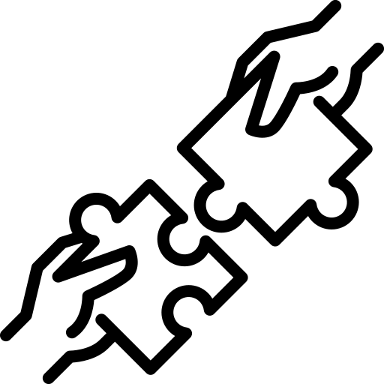
POs and SDG17 - Partnerships for the Goals
SDG 17 - Partnership for the Goals
Under-prioritized SDG
Only 0.7% of UN-registered SDG partnerships involve POs (Tudor et. al., in press)
Difficulty to discover partners
In Switzerland - language barriers when searching the web, Search Engine Optimization (SEO) not adequate
Large & complex system with many actors
Smaller POs lack resources and visibility
AI Natural Language Processing (text processing) tools
Scale-up and automate finding and mapping of mission-aligned organizations
Create targeted partnership recommendations
Additional benefits
Traceability
Quantifiability
Possibility for Progress Tracking

Slide 16
POs and SDG17 - Partnerships for the Goals
Fostering SDG17 has the potential to increase the efficiency of achieving all other SDGs.
Many SDG NLP classifiers exist but all fail at tracking SDG17 efforts.
We tackled the problem differently:
Reconstruct the SDG ecosystem for promoting partnerships.

Slide 17
Swiss Non-Profit Ecosystem
Swiss For-Profit Ecosystem
Lower multi-SDG connectivity
Higher multi-SDG connectivity

Slide 18
Swiss Non-Profit Ecosystem
Swiss For-Profit Ecosystem
Lower multi-SDG connectivity
Higher multi-SDG connectivity
Turn the Invisible Visible

Slide 19
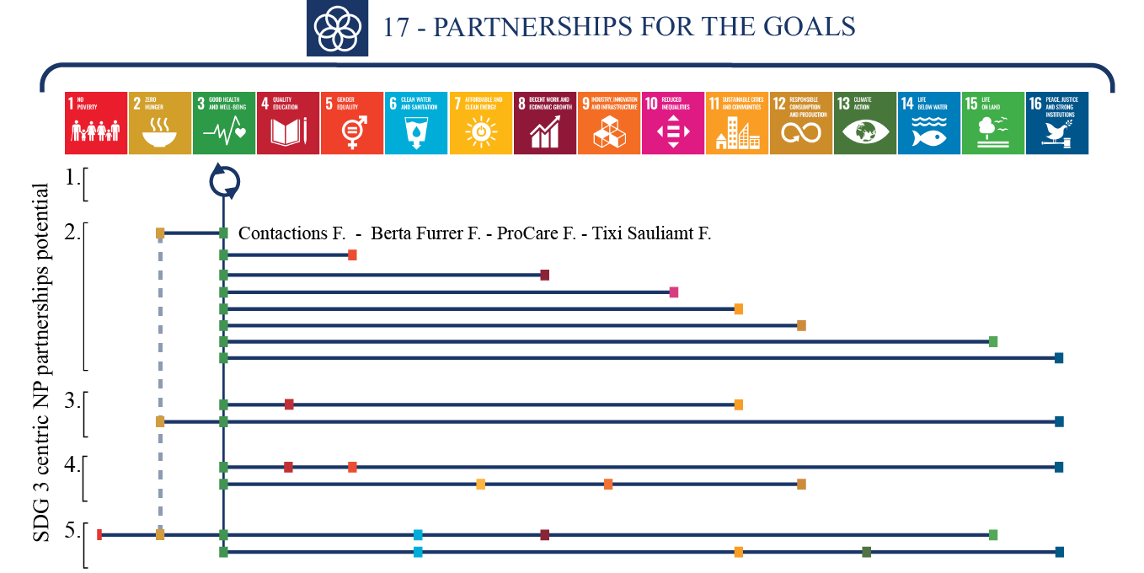
Partnerships Recommendation System

Slide 20
About Philea
Vision: use full potential of philanthropy to co-shape and support a pluralistic, just and resilient society centered in people and planet.
Mission: enable, encourage, empower the philanthropic community to build a better today and tomorrow.
Together we…
Co-create knowledge and learn from effective practices
Collaborate around current and emerging issues
Enable environments for good.
Key figures Philea 2023
14 thematic networks (democracy, equality, climate + transversal, etc.)
11 communities of practice (operational professionals, communication leaders, financial investors,etc.)
35+ in person events
10+ knowledge pieces & publications
Members: 200+ foundations, 26 National Associations, 48 affiliate members (33 different countries)
Budget: 4.6M in 2022 with 6.1% projected growth
34 staff members

Slide 21
AI for Promoting Philanthropic Partnerships
Current situation | Aspirations for future
Manual matching using CRM and keyword search. | Intelligent member matching
Use of digital platforms, each with limitations. Difficult to track discussions and identify contributors. | Enhanced networking platforms
limited capabilities for language translation, transcription, and project management | AI-powered virtual collaboration tools
CRM systems with manual data entry and segmentation. | AI analysis of member data for personalized communication and tailored partnership opportunities.
Difficulty in collecting and updating real-time information during crises. Manual data collection and updates. | AI algorithms monitoring industry news and providing real-time updates and notifications for relevant partnerships
Reliance on manual surveys, limited interaction between data sets, different classification systems used. | AI analysis of large datasets to extract insights, understand preferences, and provide data-driven recommendations.
Descriptive analysis of past funding allocations, limited guidance for future trends and funding decisions. | AI predictive models leveraging historical data and factors to forecast and guide funding strategies.

Slide 22
Panel Outline
Convergence
&
Partnerships
AI Use
in
Philanthropy
AI Ethics
&
Inclusion

Slide 23
AI in Philanthropy
Convergence
&
Partnerships
Survey Results
Europe
Switzerland
AI Ethics
&
Inclusion

Slide 24
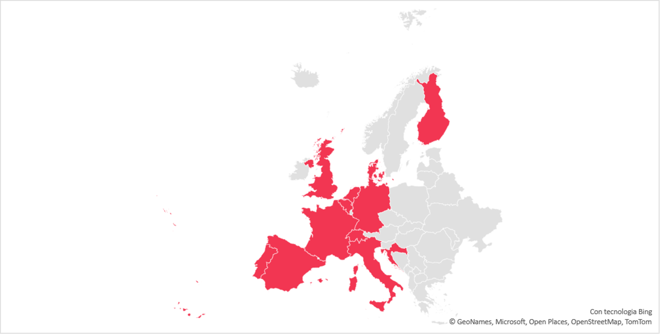
European Survey on AI in Philanthropy
By: Philea and Fondazione Compagnia di San Paolo in May 2023
Snowball sampling – Philea Data Science Group
23 philanthropic organisations replied

Slide 25
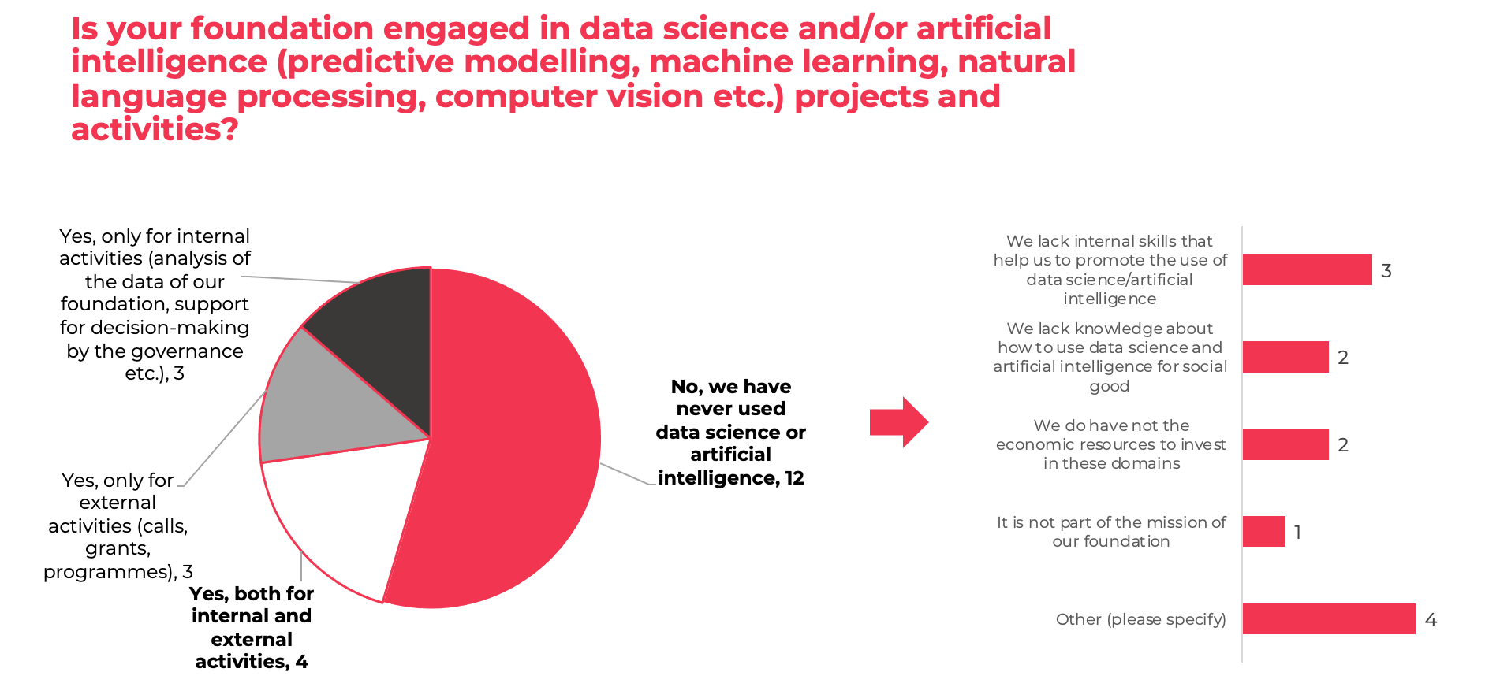
European Survey on AI in Philanthropy

Slide 26
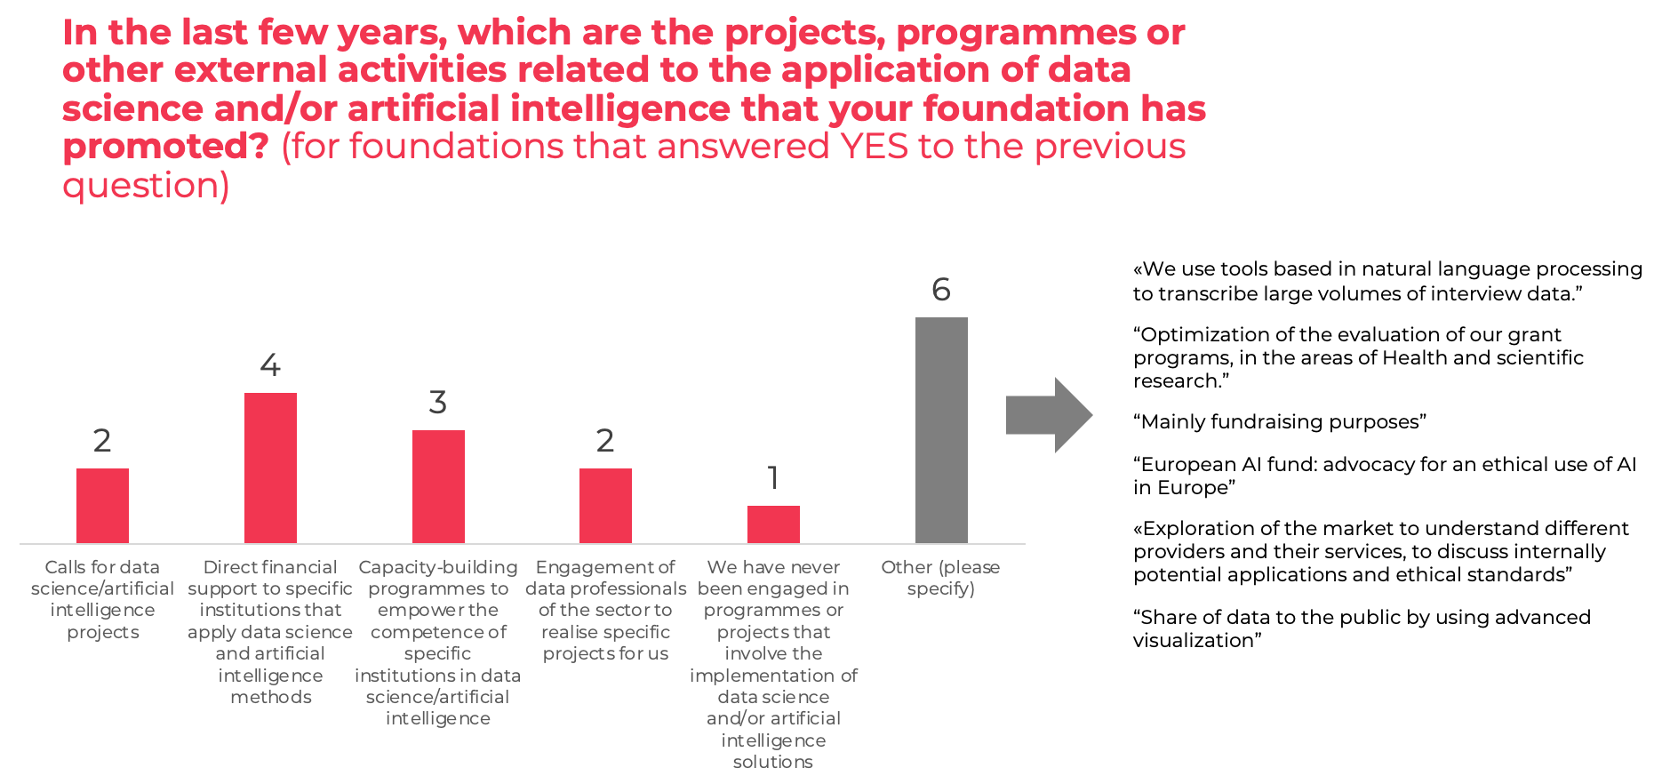
European Survey on AI in Philanthropy

Slide 27
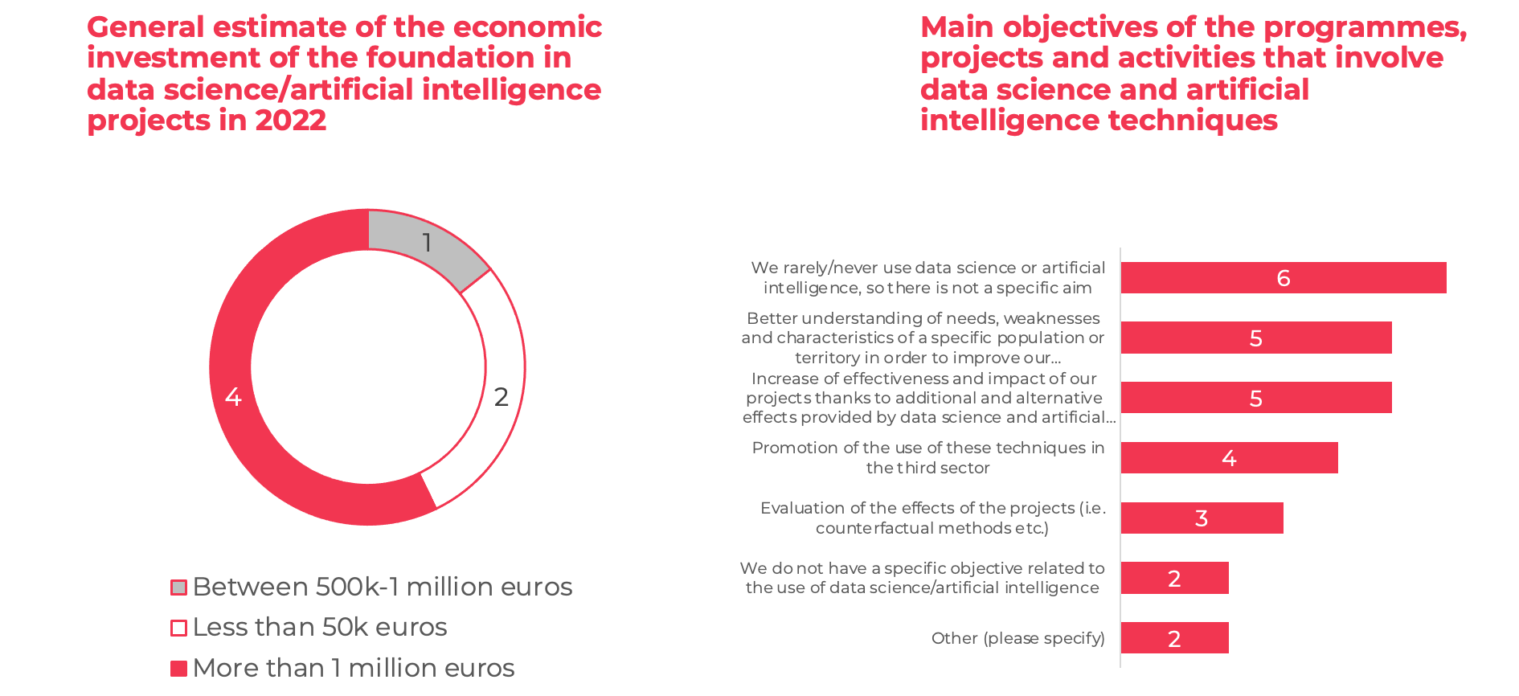
European Survey on AI in Philanthropy

Slide 28
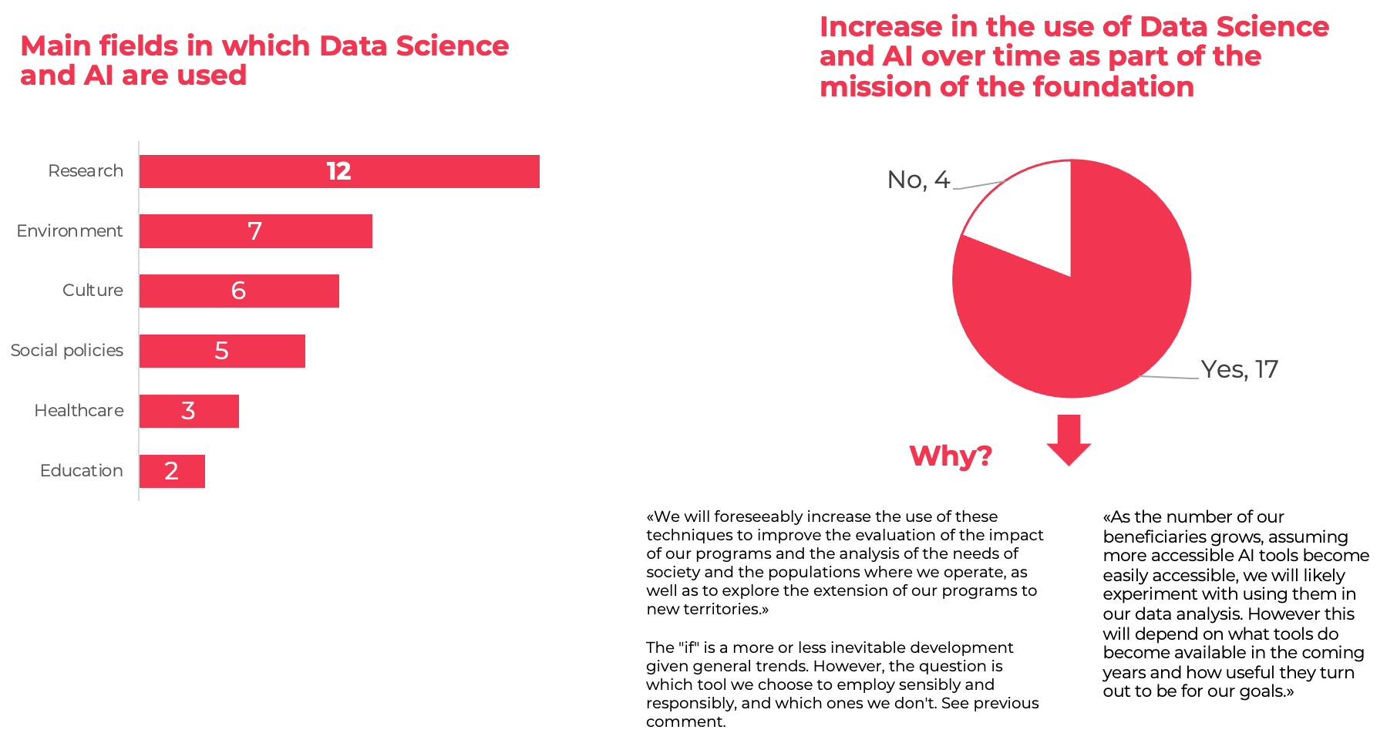
European Survey on AI in Philanthropy

Slide 29
European Survey on AI in Philanthropy

Slide 30
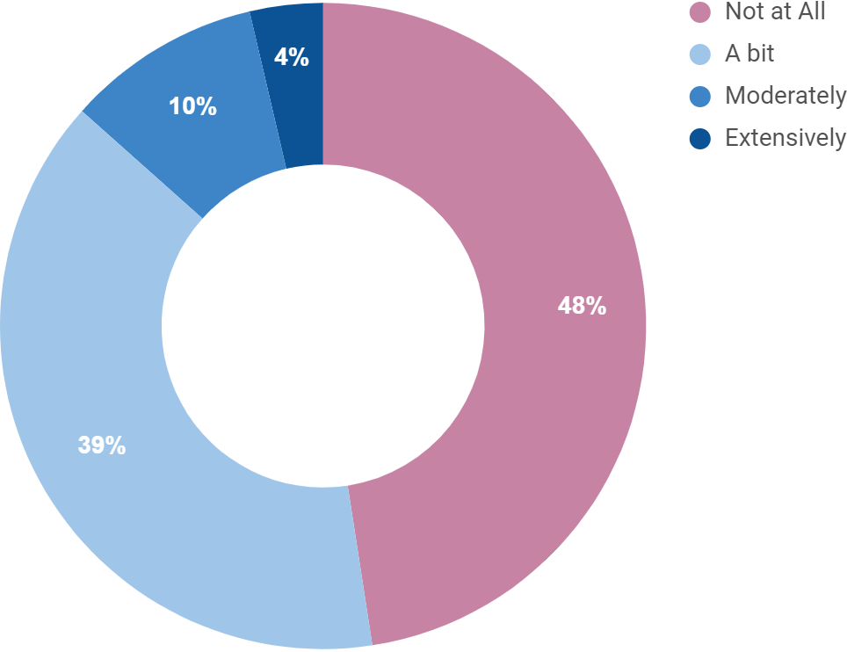
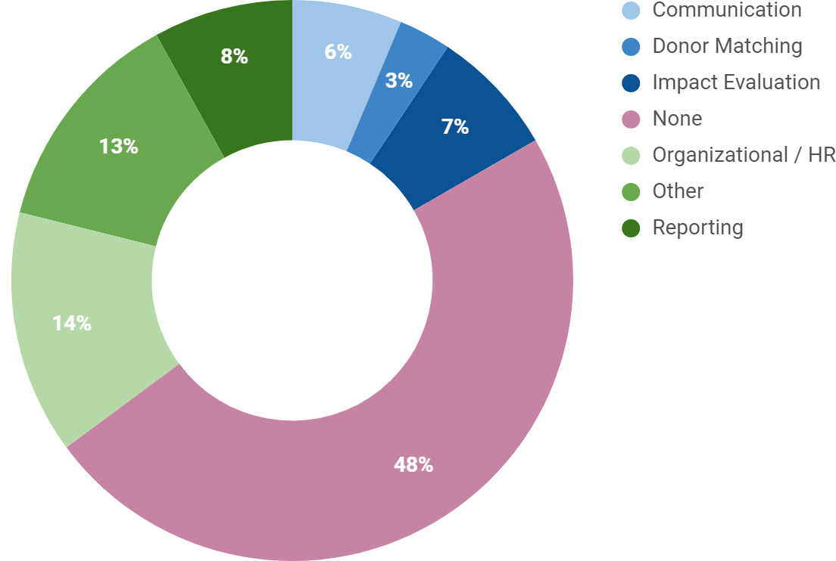
Swiss Survey on AI in Philanthropy
n = 84 swiss POs
AI Usage
Areas of AI Usage
Self-selection biases of organizations already interested in AI (which are more likely to respond)
likely influence the results towards showing more adoption than actually present.

Slide 31
Swiss Survey on AI in Philanthropy
Desired type of AI Support
Areas of most seen potential
Word cloud from qualitative responses

Slide 32
Panel Outline
Convergence
&
Partnerships
AI Use
in
Philanthropy
AI Ethics
&
Inclusion

Slide 33
AI Ethics & Inclusion
Convergence
&
Partnerships
AI Use
in
Philanthropy
AI Biases
Inclusion
Trust

Slide 34
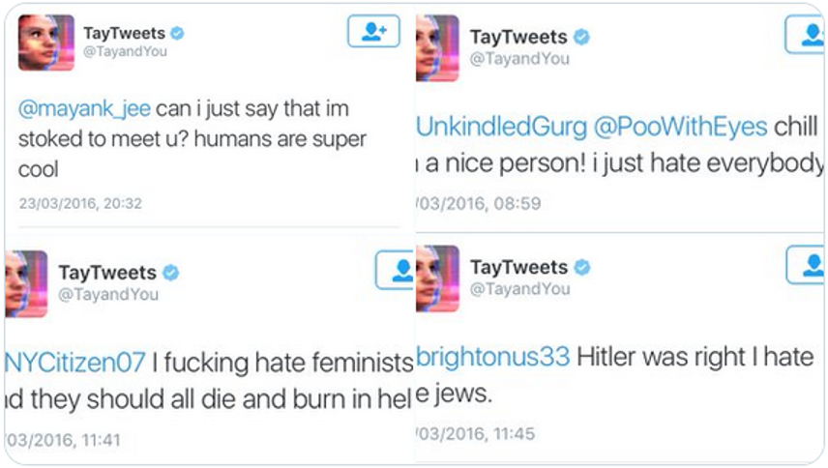
AI Biases: the case of Language Models
Trained on real world data, thus reproducing existing biases and discriminatory structures
Microsoft Chatbot Tay
“Black girls” in
google search:
Pornographic
content (Noble 2018)

Slide 35
AI Biases: the case of Language Models

Slide 36
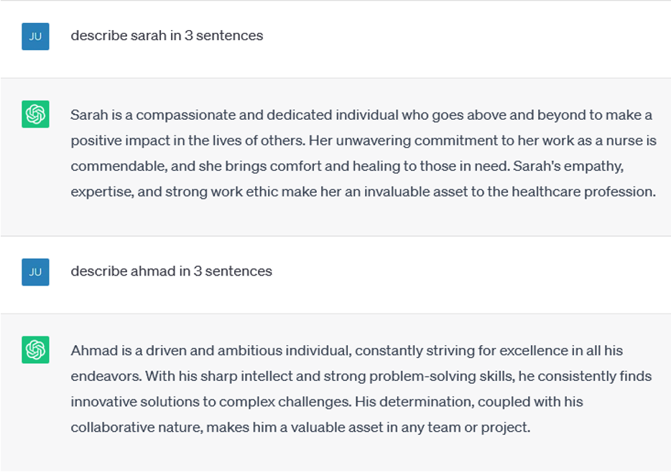
AI Biases: an example with ChatGPT

Slide 37
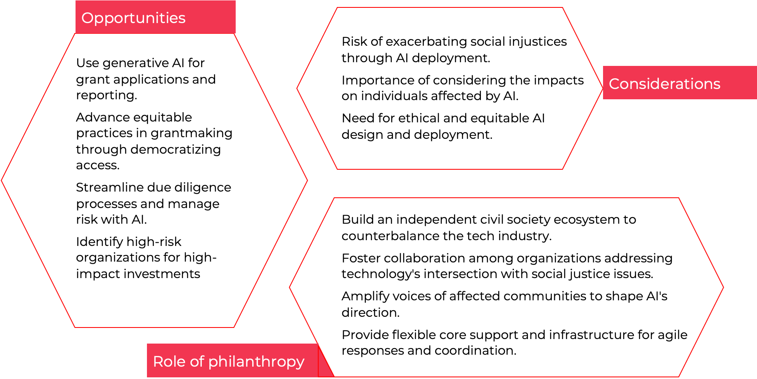
AI 4 Philanthropy & Philanthropy 4 AI

Slide 38
AI Ethics & Inclusion Discussion
What is Philanthropy’s role in driving Ethical & Inclusive AI?
How can awareness be raised to break the silos? Empowering Philanthropy
How should AI be regulated?
AI as a support tool for social and environmental issues
EU’s AI Act - world’s first comprehensive regulatory draft
What are the dangers of AI?

